Slide 1
Programmable peripheral interface 8255
Md. Fazle Rabbi
ID:16CSE057

Slide 2
Contents
8255 PPI
Block Diagram of 8255 PPI
Function of Blocks
Pin Diagram of 8255 PPI
Function of Pins
Operating Modes Of 8255
Control Word Format in I/O mode

Slide 3
8255 PPI
The INTEL 8255 is a 40 pin IC having total 24 I/O pins.
consisting of 3 numbers of 8 –bit parallel I/O ports(i.e. PORT A, PORT B,PORT C).
It requires 4 internal addresses and has one logic LOW chip select pin.
Its main functions are to interface peripheral devices to the microprocessor.

Slide 4
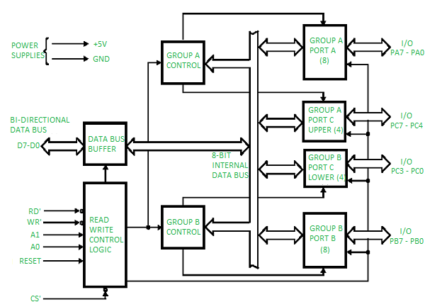
Block Diagram of 8255 PPI

Slide 5
Function Of Blocks
Data Bus Buffer
Read/write
Control logic
Port A
Port B
Port C

Slide 6
8255 – Block diagram Description
Data Bus Buffer
This three-state bi-directional 8-bit buffer is used to interface the 8255 to the system data bus. Data is transmitted or received by the buffer upon execution of input or output instructions by the CPU. Control words and status information are also transferred through the data bus buffer.
Read/Write and Control Logic
The function of this block is to manage all of the internal and external transfers of both Data and Control or Status words. It accepts inputs from the CPU Address and Control busses and in turn, issues commands to both of the Control Groups.

Slide 7
8255 – Block diagram Description
(CS) Chip Select. A "low" on this input pin enables the communication between the 8255 and the CPU.
(RD) Read. A "low" on this input pin enables 8255 to send the data or status information to the CPU on the data bus. In essence, it allows the CPU to "read from" the 8255.
(WR) Write. A "low" on this input pin enables the CPU to write data or control words into the 8255.
(RESET) Reset. A "high" on this input initializes the control register to 9Bh and all ports (A, B, C) are set to the input mode.

Slide 8
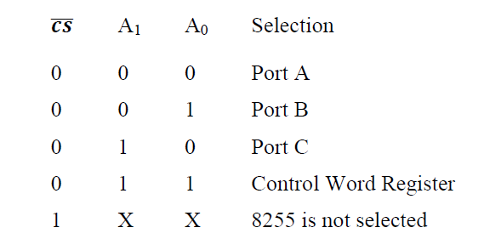
8255 – Block diagram Description
(A0 and A1) Port Select 0 and Port Select 1. These input signals, in conjunction with the RD and WR inputs, control the selection of one of the three ports or the control word register. They are normally connected to the least significant bits of the address bus (A0 and A1).

Slide 9
8255 – Block diagram Description
Group A and Group B Controls
The functional configuration of each port is programmed by the systems software. In essence, the CPU "outputs" a control word to the 8255. The control word contains information such as "mode", "bit set", "bit reset", etc., that initializes the functional configuration of the 8255. Each of the Control blocks (Group A and Group B) accepts "commands" from the Read/Write Control logic, receives "control words" from the internal data bus and issues the proper commands to its associated ports.

Slide 10
8255 – Block diagram Description
Port A One 8-bit data output latch/buffer and one 8-bit data input latch.
Port B One 8-bit data input/output latch/buffer and one 8-bit data input buffer.
Port C One 8-bit data output latch/buffer and one 8-bit data input buffer (no latch for input). This port can be divided into two 4-bit ports under the mode control. Each 4-bit port contains a 4-bit latch and it can be used for the control signal output and status signal inputs in conjunction with ports A and B.

Slide 11
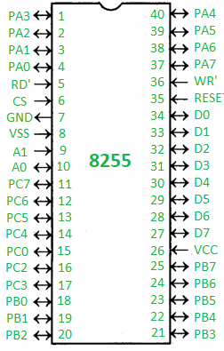
Pin Diagram of 8255 PPI

Slide 12
Function Of Pin
D0-D7 (Data Bus)
PA0-PA7 (Port A)
PB0-PB7 (Port B)
PC0-PC7 ((Port C)
RD
WR
CS
RESET
A0-A1

Slide 13
Interfacing 8255 with 8085 processor

Slide 14
Operating Modes Of 8255
• There are two main operational modes of 8255:
(1) Input/output mode,
(2) Bit set/reset mode (BSR Mode).
I/O mode again classified into three types
(1) Mode 0,
(2) Mode 1,
(3) Mode 2.

Slide 15
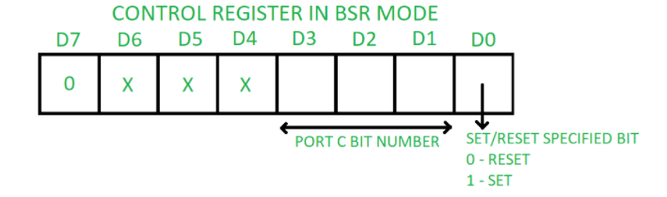
Bit set Reset(bsr) Mode
If MSB of control word (D7) is 0, PPI works in BSR mode.
In this mode only port C bits are used for set or reset.

Slide 16
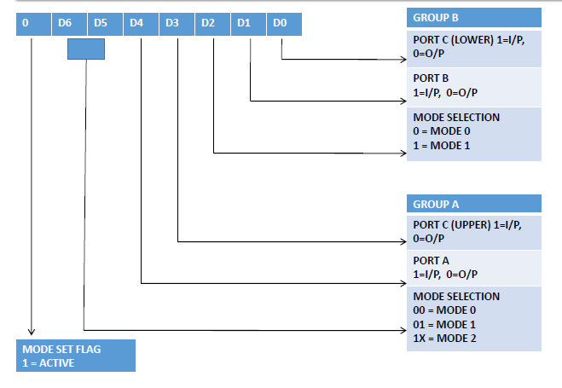
Control Word Format in I/O Mode

Slide 17
Mode 0
• In this mode, the ports can be used for simple input/output operations without handshaking.
• If both port A and B are initialized in mode 0, the two halves of port C can be either used together as an additional 8-bit port, or they can be used as individual 4-bit ports.
• Since the two halves of port C are independent, they may be used such that one-half is initialized as an input port while the other half is initialized as an output port.
NB : In this mode all the three ports (port A, B, C) can work as simple input function or simple output function

Slide 18
Mode 1
The mode 1 has following features:
• Two ports i.e. port A and B can be use as 8-bit i/o port.
• Each port uses three lines of port c as handshake signal and remaining two signals can be function as i/o port.
• Input and Output data are latched.

Slide 19
Mode 2
•Only group A can be initialized in this mode.
•Port A can be used for bidirectional handshake data transfer. This means that data can be input or output on
the same eight lines (PA0 - PA7).
•Pins PC3 - PC7 are used as handshake lines for port A.
•The remaining pins of port C (PC0 - PC2) can be used as input/output lines if group B is initialized in mode 0.
• In this mode, the 8255 may be used to extend the system bus to a slave

Slide 20
THE END

